Slide 1
Solo meeting 08/28/2024

Slide 2
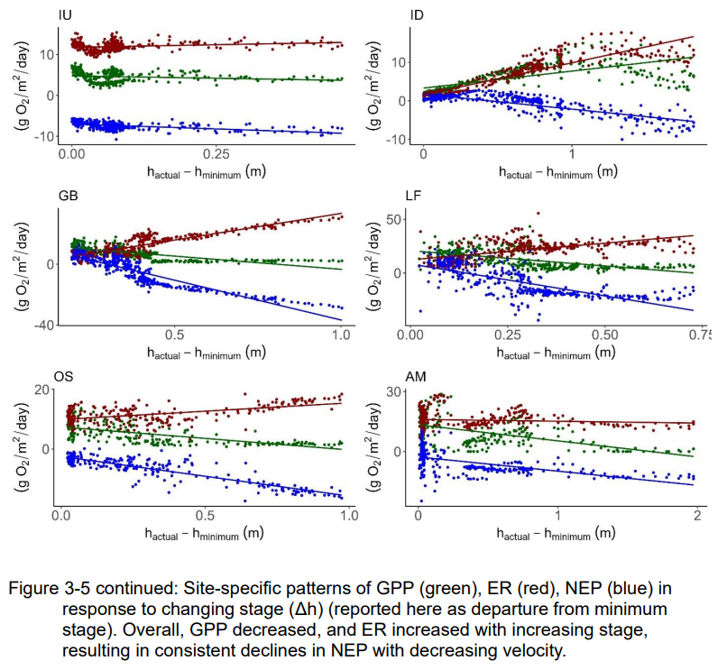
Thesis figure

Slide 3
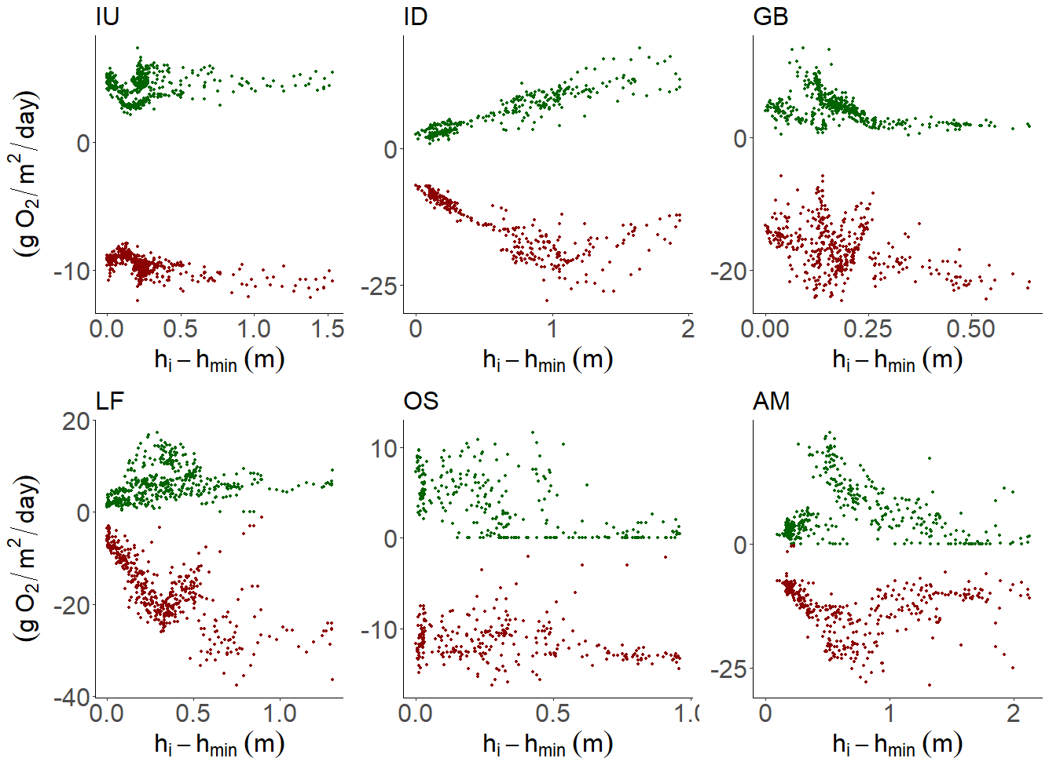
Pre- 09/20/2024

